Slide 1

Customer Engagement Points Introduction
Recognizing “who are we in service of” and value that is delivered
Using the pallet of shapes
  Capture the various roles across to either the direct or indirect spheres
  Identify the relationships (e.g. in service of, in service of)
  For both the direct and indirect engagement points identified, try to articulate the valued activities delivered.
Two templates sets are provided
  Slide 2-3: Engagement circles are a background image (easiest to use)
  Slide 4-5: Full control on sizing & moving engagement circles (a little more difficult to use)
Customer A
Customer B
in service of
in service of – in service of
How we will help them?
Attend scoping meetings
Provide guidance on method
Support artifact modeling
… in order to help them?
Engage business stakeholders
Demonstrate value of architecture to solve business problems

Slide 2
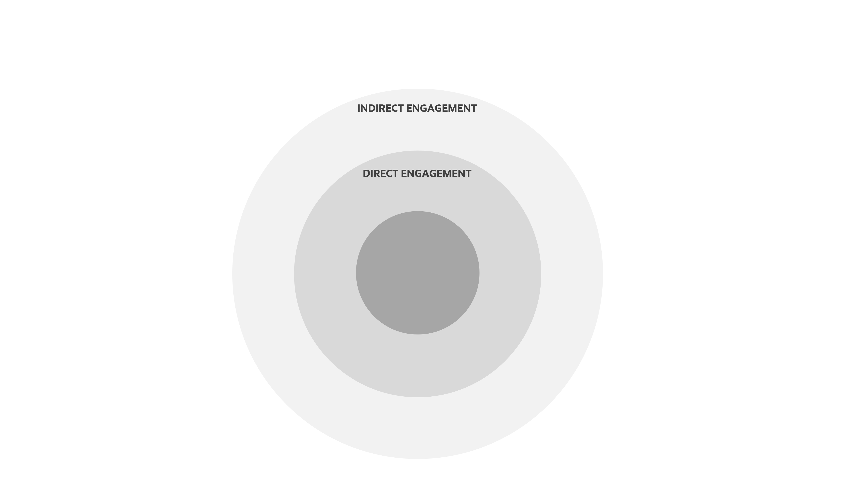
Identifying our customers
Indirect, Direct & Organization circles is a background image
Pallet
How we will help them?
List value activities
Customer
In order to help them?
List value activities
Customer
Organization

Slide 3
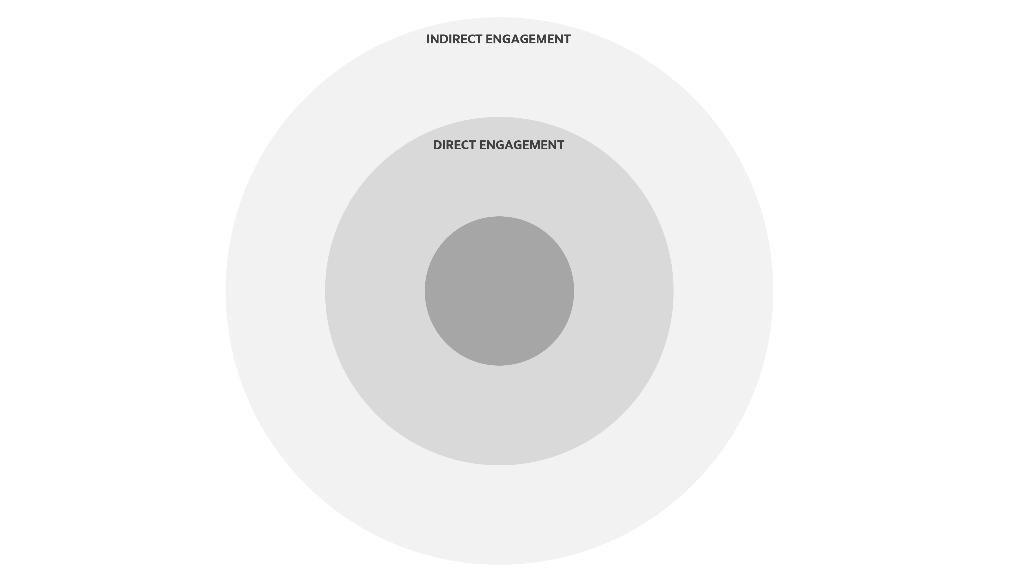
Indirect, Direct & Organization circles is a background image
Pallet
How we will help them?
List value activities
Customer
Organization
In order to help them?
List value activities
Customer

Slide 4
Identifying our customers
Full control on Indirect, Direct & Organization circles
INDIRECT ENGAGEMENT
Pallet
DIRECT ENGAGEMENT
How we will help them?
List value activities
Customer
In order to help them?
List value activities
Customer
Organization

Slide 5
INDIRECT ENGAGEMENT
Full control on Indirect, Direct & Organization circles
DIRECT ENGAGEMENT
Pallet
How we will help them?
List value activities
Customer
Organization
In order to help them?
List value activities
Customer

